Slide 1
Narratives and the Construction
of Environmental Responsibility
By J. Baird Callicott
University Distinguished Research Professor
Regents Professor of Philosophy
Department of Philosophy and Religion Studies
United Nations Educational, Scientific, and Cultural Organization
Paris, France
4 Juin, 2012

Slide 2
For UNESCO
Talk will center on narratives in relation to all three of UNESCO’s
signature themes + 1 = environment (belonging to UNEP)
Cultural foundations and functions of narratives
The role of narratives in education
Science and narrative
Case studies of narratives for the construction of
environmental responsibility

Slide 3
Personal Narratives and Collective Narratives
Narratives are stories involving actors (characters) and action
unfolding in a temporal sequence.
Personal narratives can be inconsequential and forgettable Twitter fodder
—my shopping trip, my summer vacation; OR they can be
identity-shaping—for me: how I discovered philosophy;
from Civil Rights to nature’s rights; how I met the love of my life.
Collective narratives are a common cultural possession and are often
also identity-shaping, taking the form of cosmogony (Genesis,
Theogony), history (storming the Bastille), and religion (the
passion of Christ).

Slide 4
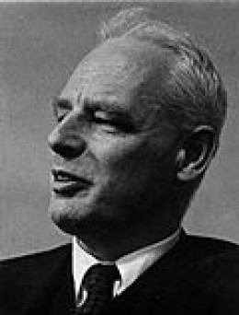
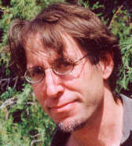
Eric Havelock
Collective Narratives as Cultural Repositories
Full alphabetical literacy (a phonetic alphabet) has
existed for only ~3000 years. Among other
impacts, writing is a new technology for
externally storing the cognitive (as distinct
from the material) aspects of culture.
Before the advent of literacy, a culture’s cognitive
content was stored internally, in the human
brain—in the wetware.
Thus much human brain power was devoted to
storage; and a premium quality of human
intelligence was memory.
In oral cultures collective narratives functioned as mnemonic devices.
David Abram

Slide 5
Narratives as Cultural Repositories
Narratives involve characters (actors) and actions that unfold in a
temporal sequence—and so are more easily remembered.
Important cultural information—e. g., the recipe for a wound-healing
posit or how to build a sea-going vessel—can be attached to
action episodes. A story’s action episodes then serve as a
kind of index for locating a currently relevant bit of
important cultural information.
The Dreamtime narratives of the Australian Aborigines serve as
maps for safely walking through country, finding water, and
reaching a destination without getting lost.
And the point of many collective narratives is a “moral lesson.”

Slide 6
Narratives as Cultural Repositories
The Deamtime narratives are songs, so although a young person on a
Walkabout may never have gone there himself, he can sing his
way to a destination.
Song-form is another mnemonic device. Songs have meter and rhyme
as well as varying pitch. Only the right sequence of words will
fit the metric form of the song-poem. Thus any deviation from
faithful reproduction can be recognized—because it doesn’t fit
the metric form—and can be corrected.
The canon of collective narratives in ancient Greek oral culture was
so extensive that specialists, called rhapsodes, emerged to store
it all and faithfully reproduce it for the benefit of their audiences.
Some could unerringly recite the entire Iliad and Odyssey, the
major opuses of Homer’s enormous oevre.

Slide 7
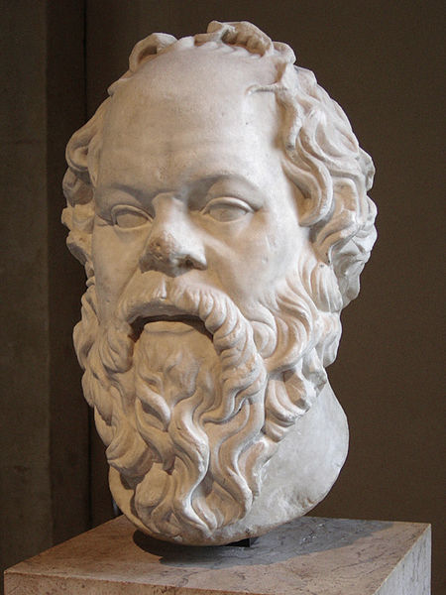
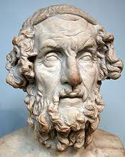
Narratives as Vehicles of Education on Oral Cultures
By the time of Socrates, ancient Greek formal education
consisted entirely of memorizing narrative
poetry and reciting it accompanied by the lyre.
And if you wanted to answer a philosophical question—What is
justice?—such as Socrates poses to Polemarchus at the
beginning of the Republic, you scanned your memory
for the answer given by one of the poets
(in that instance Simonides).
Not for nothing was Homer called “the educator of
Greece”

Slide 8
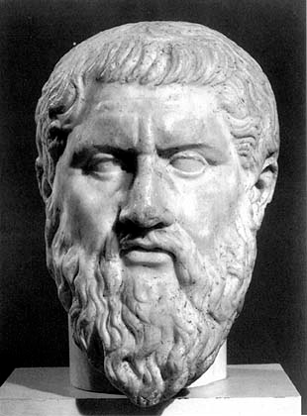
Narratives as Vehicles of Education in Oral Cultures
Plato lived on the cusp of the Greeks’ transition from
orality to literacy and tells a tale in the Phaedrus about
the inventor of writing, the Egyptian god Theuth, who in
presenting his invention to the Egyptian King Thamus,
claimed that writing
“once learned, will make the Egyptians wiser and improve their memory;
I have discovered a potion for memory and wisdom.” King Thamus
replied, “In fact it will introduce forgetfulness into the soul of those who
learn it: they will not practice using their memory because they will put
their trust in writing, which is external and depends on signs that belong
to others, instead of trying to remember from the inside, completely on
their own. You have not discovered a potion for remembering but for
reminding; you provide your students with the appearance of wisdom,
not its reality . . . And they will be difficult to get along with, because
they will merely appear to be wise instead of really being so.”

Slide 9
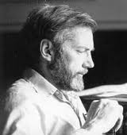
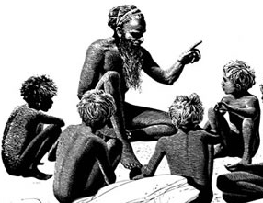
Narratives as Vehicles of Education in Oral Cultures
American Postmodern Primitivist Paul Shepard
points out that writing is learned with difficulty and
that non-narrative, academic writing is even more
difficult to master and requires constant practice to
maintain proficiency. But listening to stories and
telling them comes to us naturally and with ease.
For at least 50,000 years we have been
listening to stories. Our brains and minds
are hard-wired to receive information in
the form of narratives. And we all spent
the most formative part of our lives as
oral beings, naturally enraptured by oral
narratives, which we demand to be repeated
over and over again—for that’s how we
evolved to acquire our cognitive cultures.

Slide 10
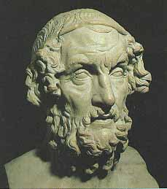
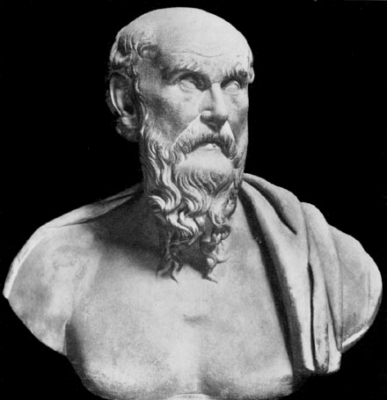
Grand (Master) Narratives
In a complex and dialectical way, the interaction
between two means of storing and transmitting
cognitive culture at the cusp of orality and
literacy produced a few “grand” or (more
tendentiously) “master” narratives. By the time
of Socrates, the epics of Homer and Hesiod had
been cast in writing and with that they became
standardized and were universalized in the
Grecophone world. The Olympian religion
became a grand narrative framing and organizing
the experience of all those under its egis.

Slide 11
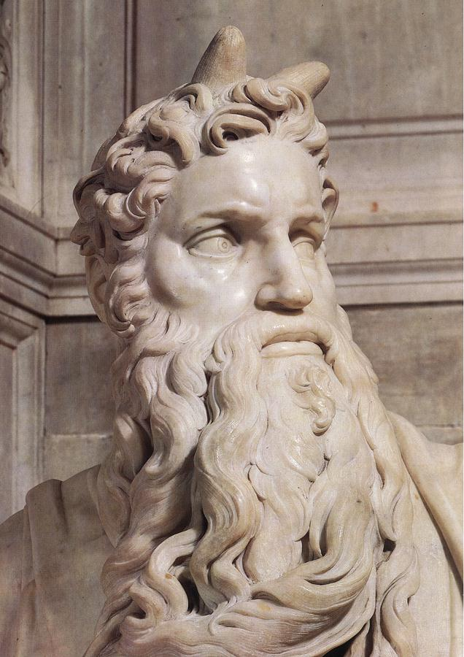
Grand (Master) Narratives
Moses
At about the same time, the Hebrew myths were
cast in writing and they too became a grand
narrative framing and organizing the experience
of all those whom they enthralled. The
transformation of the spoken word to the written
word somehow gave it fixity and a new power and
majesty to become unshakable Truth, the word of
God. The book itself became sacred, an object of
worship. How little we reflect on this on strange
phenomenon: A book, the Bible, is holy writ,
incarnate truth, the centerpiece of a portable
religion detached from place and materiality.

Slide 12
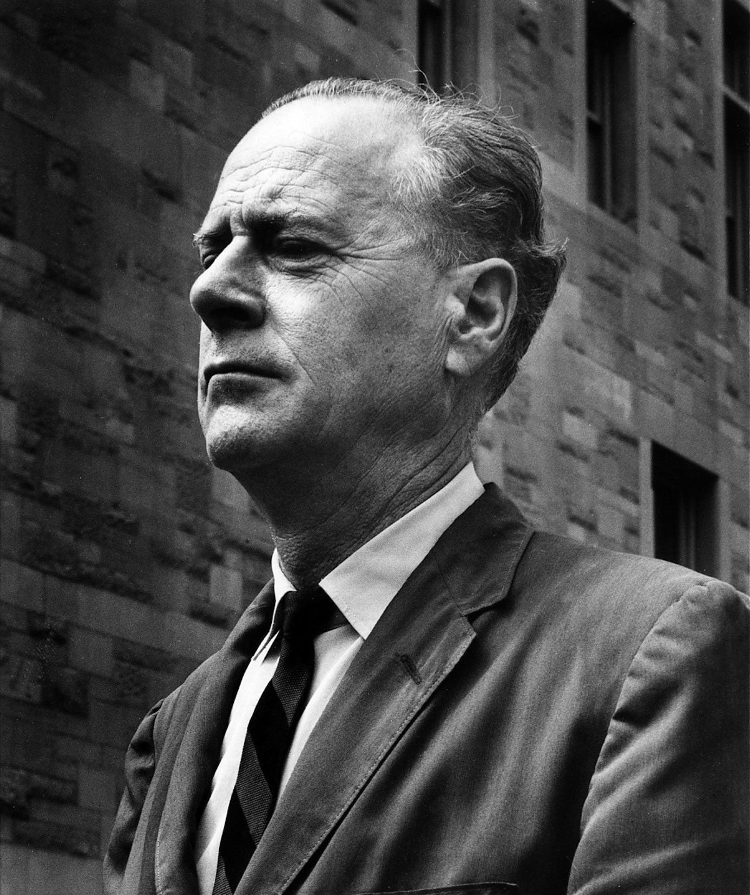
How Alphabetical Literacy Transformed Human Consciousness
Intensified interiority and created individuality (speech is public and
communal, reading and writing is private and personal)
Thus it intensified fear of death and stimulated
eschatology (Pythagoras, Empedocles, Plato)
Privileged stasis over change—the written word
exists in static space, the spoken word in dynamic
time (Parmenides)
Made abstract ideas possible—because a word appeares in two
material manifestations its meaning was neither something heard nor
something seen (Platonic forms)
• Privileged prose over poetry (no need for formal mnemonic aid)
Marshall McLuhan

Slide 13
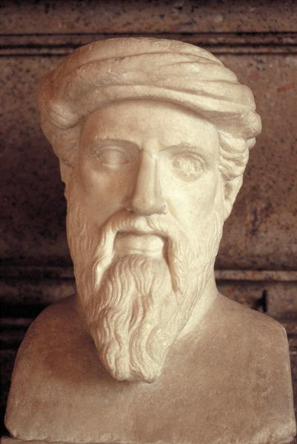
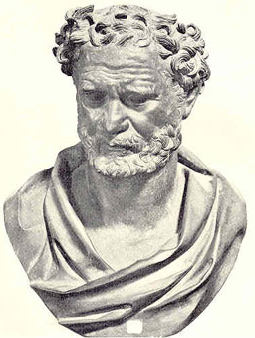
Science as non-Narrative
Pythagoras
Ancient science emerged on the near side of the orality-
literacy boundary, the quintessential cognitive
expression of the kind of human consciousness made
possible by literacy—
• Fabricated of abstract ideas
Expressed in prose not poetry
Born of idiosyncratic, individual thought
Natural causes for natural phenomena
No supernatural agents
No actors, no action
Putatively rational
Thus inviting logical analysis and criticism
Reduction of qualitative variation to quantitative
Progressive via a dialectical development of ideas
After the 17th century, progress via the experimental
method
Democritus

Slide 14
Science as Grand non-Narrative
Scientific discourse is not narrative, but it usurps the cultural function of
grand narratives.
It provides a cosmogony (the Big Bang) and cosmology (finite, “curved,”
four-dimensional space-time) populated by beings of titanc
proportion—black holes, galaxies, stars, planets.
It is identity shaping (the evolutionary tree of life), providing an extended
genealogy back through our hominid progenitors, through the
amphibians that made the transition of animal life from the sea to
the land, and finally to those ancestral forms mothered in the
oceans.

Slide 15
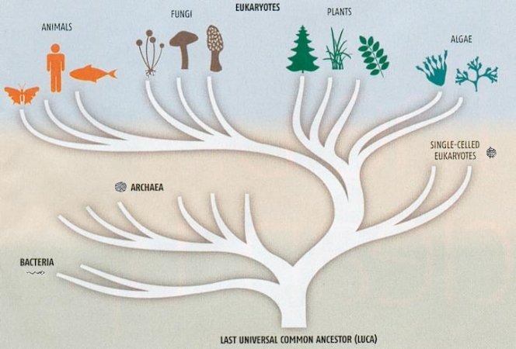
Science as Grand non-Narrative
What is sometimes called the “Epic of Evolution” is very disturbing and
frightening to many fundamentalist Christians in the US. But why?
Because, unlike say Quantum Theory or the Theory of Relativity, the
Theory of Evolution has quasi-narrative qualities and threatens to
function like the older
biblical narratives
born in the
consciousness of
orality and embalmed
and disseminated by
the technology of
literacy.

Slide 16
Why the Discourse of Science is Alienating
Perhaps because scientific discourse does not stimulate the narrative
receptors in the human brain
Scientific discourse is
Static
Abstract
Quantitative
Compartmentalized (by disciplinary silos)
Impersonal
Undramatic
Spiritually depauperate
Aesthetically unappealing
Inaccessible
Sequestered in gated and cloistered magisteria

Slide 17
The Narrativization of the Scientific Worldview
But science does have a story to tell; and the story it has to tell is one
to which we must listen as a matter of life and death.
The Dreamtime songlines guide a walker through terra incognita. Grand
narratives also serve as guides for action. What environmental
policies are we likely to pursue if we believe that the world was
created only ~6000 years ago; that humans were created in the
image of God, given dominion over creation and a mandate to
subdue it? Many members of the US Congress, some former
candidates for the Republican presidential nomination and a large
portion of the US population profess to believe just that. And
many also profess to believe that we live in the “End Times” and
thus that concern for the world that the present generation
will bequeath to future generations is a misplaced concern. And
many believe that only God can change the Earth’s climate.

Slide 18
The Narrativization of the Scientific Worldview
Telling the story that science has to tell as a narrative, making that
narrative persuasive, and actualizing its aesthetic and spiritual
potential is vital for the sustainability of global civilization.
A caveat: The story science has to tell is just one story among many.
We have no greater access to the Unvarnished Truth via the
scientific method than did Hesiod who was informed by his muses
or Moses who was informed by his God. All stories—that of
science especially—are made up, “composed” as Bruno Latour is
fond of saying. The difference, Latour says, is not one of kind but
of quality. Some stories are well composed, others badly
composed. The story science has to tell has one crucial check on
bad composition—a hermeneutic of suspicion, a culture of
disputation, and an epistemology of falsifiability—making its
story unceasingly self-correcting and permanently tentative.

Slide 19
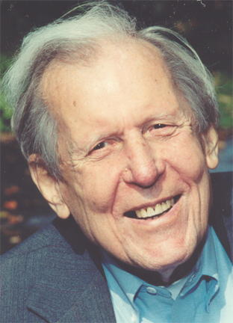
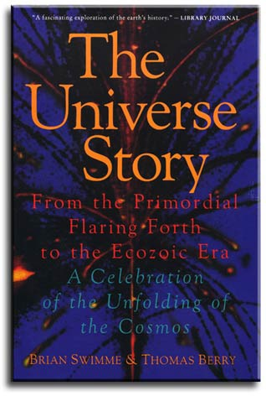
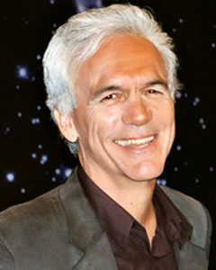
The Narrativization of the Scientific Worldview
To tell the vital story that science has to tell to a listening lay
audience that story has to be told as a story—as a narrative.
Thomas Berry, a heretical Jesuit,
teamed up with Brian Swimme,
a physicist, to tell The Universe
Story—the “epic” of cosmic
evolution from the Big Bang to
the origin of life on Earth to the
evolution of “man”—as a better,
more persuasive alternative than
the primitive story of the universe
told in Genesis.

Slide 20
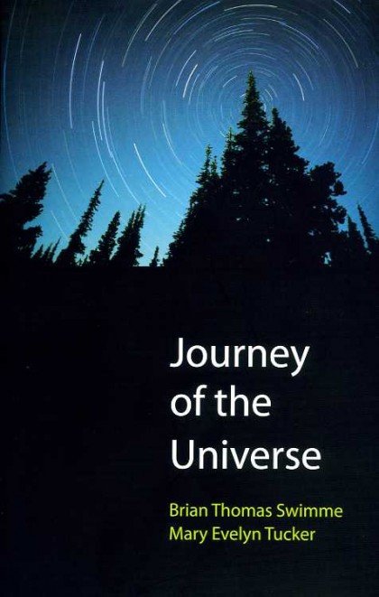
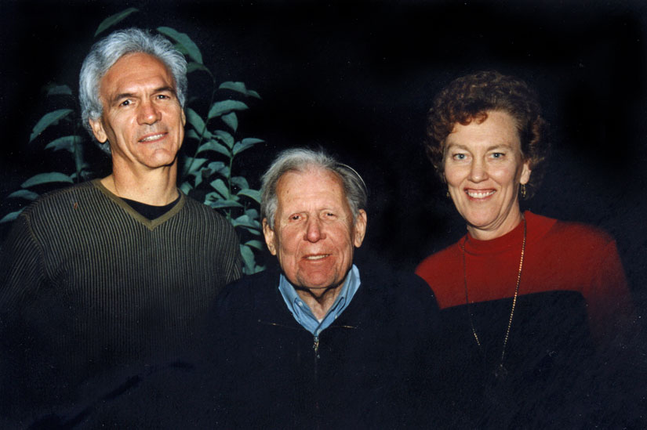
The Narrativization of the Scientific Worldview
Berry’s student Mary Evelyn Tucker
collaborated with Swimme to make
Journey of the Universe, a feature-length
film,which is not only a narrative, but a
sort of high-brow telenovela.

Slide 21
The Narrativization of the Scientific Worldview
There is no moral to the story of cosmic evolution. Ethics is scale-
dependent. That the Earth will be consumed by the sun, in its
senescence as a red giant, in ~5 billion years is neither good
nor bad, neither right nor wrong.
That the Earth experienced 5 mass extinction events in the past—the
most recent at the K-T boundary ~65 million years ago—is not
morally reprehensible.
But that humans are presently the agents of a sixth mass extinction event
is morally reprehensible—because it falls within the spatio-
temporal window of human ethical sensibility. Mass anthropo-
genic extinction occurring right now is bad.

Slide 22
The Narrativization of the Scientific Worldview
Only the narrativized sciences at the spatio-temporal scales of human
moral concern can move us to righteous indignation and
corrective action.
Foremost among those morally-scaled sciences is ecology. It is
spatially scaled to the size of patches, biotic communities, eco-
systems, and landscapes (mosaics of patches). It is temporally
scaled to processes of succession and disturbance regimes.
With moral concern now focused on anthropogenic climate change
Earth systems sciences now press the limits of the scalar
parameters of ethics. The spatial scale is global—which is
unprecedented (as Michel Serres points out Le Contrat Naturel).
And the temporal scale is calibrated in centuries and millennia.

Slide 23
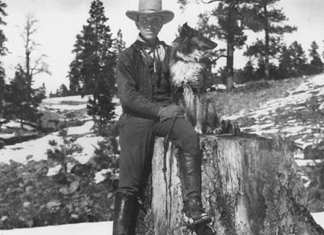
Case Study: Aldo Leopold—“Thinking Like a Mountain”
AL (1887-1948) was trained in French
forestry at the Yale Forest School
founded by Gifford Pinchot. He joined
the US Forest Service in 1909, posted
to the Southwest Territories. He was
an avid hunter and professionally
interested in “secondary” forest
resources, especially “game.”
He thought that in order to increase the game resource, it was necessary
to exterminate their predators—principally mountain lions and timber
wolves. He “thought that fewer wolves meant more deer [and] that no
wolves would mean hunters’ paradise.” “Thinking Like a Mountain”
tells a story about killing a wolf and, in the process, AL narrativises
the ecological worldview and provides a multilayered moral lesson.

Slide 24
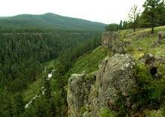
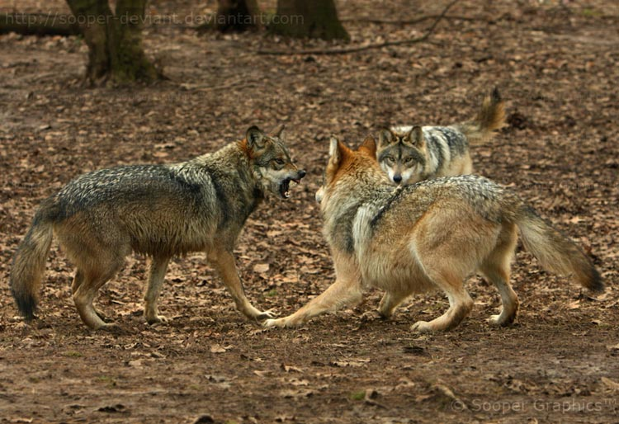
Case Study: Aldo Leopold—“Thinking Like a Mountain”
“We were eating lunch on a high rimrock,
at the foot of which a turbulent river
elbowed its way. We saw what we thought
was a doe fording the torrent, her breast
awash in white water. When she climbed
the bank we realized our error: it was a
wolf. A half-dozen others, evidently grown pups, sprang from the
willows and all joined in a
welcoming mêlée of wagging
tails and playful maulings.
What was literally a pile of
wolves writhed and tumbled
in the center of an open
flat at the foot of our rimrock.

Slide 25
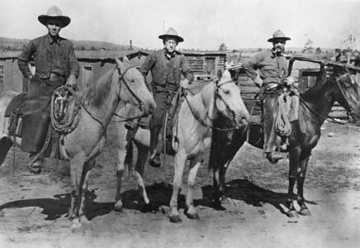
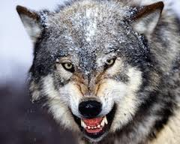
Case Study: Aldo Leopold—“Thinking Like a Mountain”
“In those days [c. 1909] we had never
heard of passing up a chance to kill a
wolf. In a second we were pumping
lead into the pack . . . . When our rifles
were empty, the old wolf was down,
and a pup was dragging a leg into
impassible slide-rocks. . . .“We reached
the old wolf in time to watch a fierce green fire
dying in her eyes. I realized then, and have
known ever since, that there was something
new to me in those eyes—something known
only to her and to the mountain.”

Slide 26
Case Study: Aldo Leopold—“Thinking Like a Mountain”
“Since then I have lived to see state after state extirpate its wolves. I
have watched the face of many a newly wolfless mountain, and seen the
south-facing slopes wrinkle with a maze of new deer trails. I have seen
every edible bush and seedling browsed, first to anaemic desuetude, and
then to death. I have seen every edible tree defoliated to the height of a
saddlehorn. . . . In the end the starved bones of the hoped-for deer herd,
dead of its own too much, bleach with the bones of the high-lined
junipers.
“I now suspect that just as a deer herd lives in mortal fear of its
wolves, so does a mountain live in mortal fear of its deer. And perhaps
with better cause, for while a buck pulled down by wolves may be
replaced in two or three years, a range pulled down by too many deer
may fail of replacement in as many decades decades.”
Spatial scale: mountain; Temporal scale: ecological succession (30 years)

Slide 27
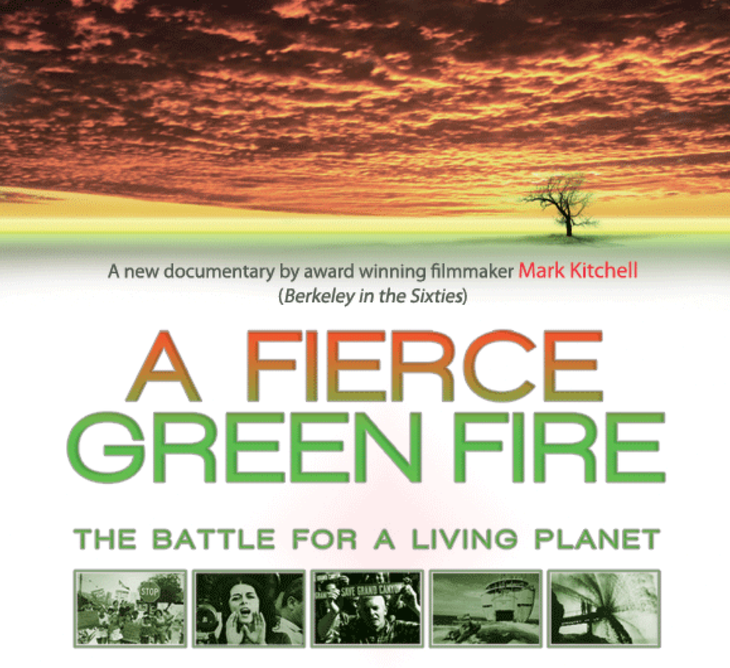
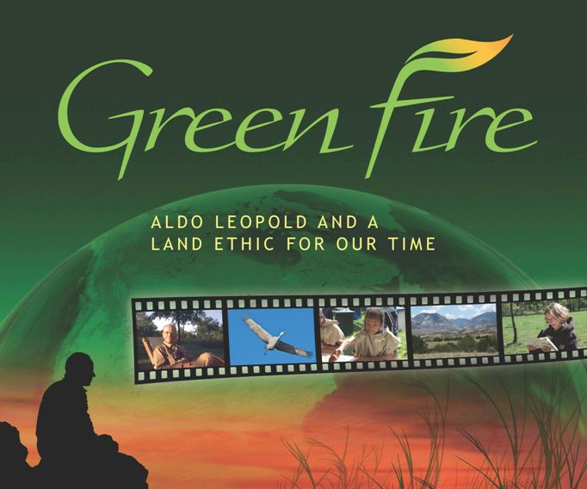
Case Study: Aldo Leopold
—“Thinking Like a Mountain”
The image and symbol of
“green fire” has become iconic

Slide 28
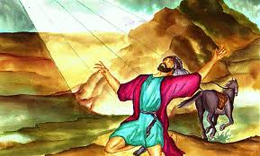
Case Study: Aldo Leopold—“Thinking Like a Mountain”
Why has that ember of green fire become a conflagration in the
environmental imaginary?
My hypothesis: Because AL’s A Sand County Almanac is crafted to
pulsate with biblical cadences, phrasings, and tropes.
On the road to Damascus, Saul of
Tarsus saw a light and heard the
voice of Jesus say to him, “Saul,
Saul, why persecutest thou me?”
It was a moment of epiphany and
transformation. Saul became Paul
The Apostle and an eloquent
advocate for Christianity.

Slide 29
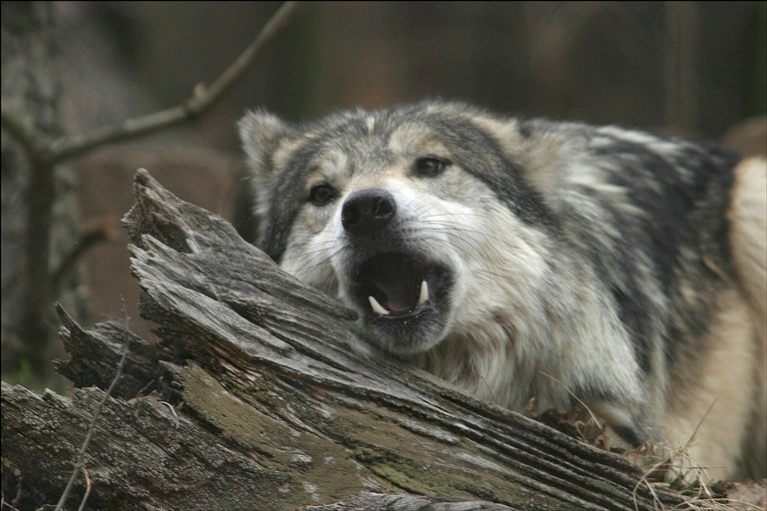
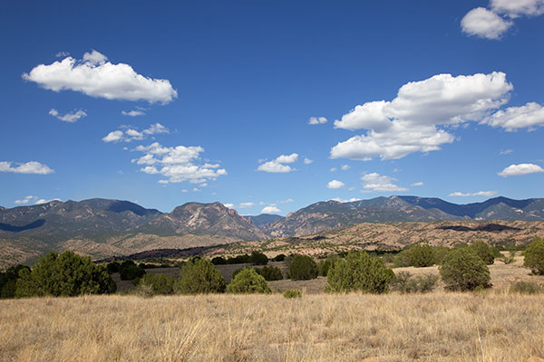
Case Study: Aldo Leopold—“Thinking Like a Mountain”
On the rimrock in Arizona, Aldo Leopold saw a light—the fierce green
fire—and the she-wolf mutely asked “Aldo, Aldo why persecutest thou
me and my kind?” Like Saul on the road to Damascus, Leopold had a
transformative epiphany; and from a persecutor of predators he became
their most eloquent advocate.

Slide 30
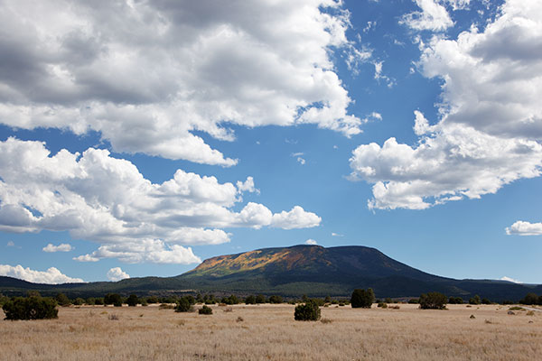
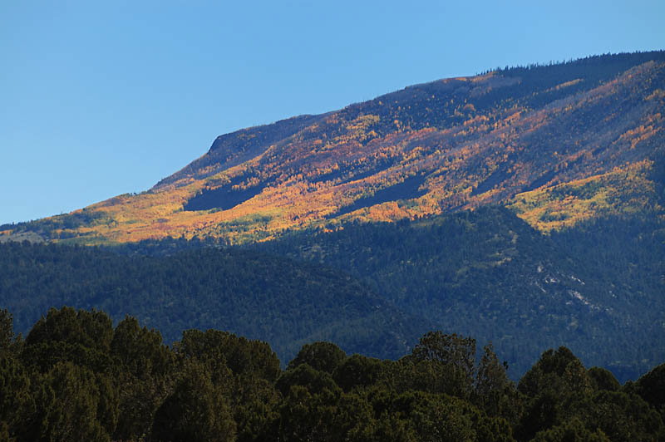
Case Study: Aldo Leopold—“Thinking Like a Mountain”
And why is it “Thinking Like a Mountain” and not “Thinking Like a
Wolf”?
Ecological reason: Because the penultimate effect of predator removal
is on the vegetation and ultimately on the soil.

Slide 31
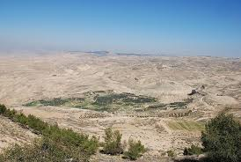
Case Study: Aldo Leopold—“Thinking Like a Mountain”
Rhetorical reason: Because mountains
have a revelatory place in the biblical
grand narrative that Leopold is
craftily expropriating for his own
anti-biblical purposes. It was on
Mount Sinai that Moses received the
Ten Commandments. It was from
Mount Nebo that God showed Moses
the Promised Land.
In the Great Martin Luther King’s most powerful
and final speech, he too channeled Moses and
declared that he had been “up to the mountain” and that he has “seen the promised land.” He said,
“I may not get there with you. . . , but that we, as
a people, will get to the promised land.”

Slide 32
Case Study: Aldo Leopold—“Thinking Like a Mountain”
Leopold doesn’t just narrativize ecology and evolutionary biology for
the edification of a lay audience, his intent is to transform these
sciences into a grand narrative of biblical proportions, to write a
new evolutionary-ecological bible for our time.
A Sand County Almanac—in which “Thinking Like a Mountain” is the
central, pivotal episode—is openly candid about its worldview
remediation project: to replace our obsolete “Abrahamic
[biblical] concept of land” with the ecological concept of
“land as a community to which belong.” To do that successfully,
AL must make his own rhetorically allude to the very narrative
that he hopes to supplant and employ its tropes and its styles of
expression. But to do that successfully, he must be subtle, crafty,
and understated. Our bible-attuned brains must be stimulated,
but in a subliminal way so that we never notice that we are being
played like an instrument in the hands of a virtuoso.

Slide 33
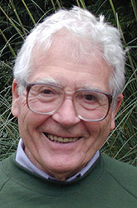
Case Study: James Lovelock—“The Gaia Hypothesis”
Earth systems sciences are even more abstract, quantitative, complex,
and inaccessible than evolutionary biology and ecology.
Just as Leopold creates a new scientific grand
narrative on a biblical scale, Lovelock creates
a new grand narrative on an Olympian scale—
nay, on a Titanic scale, for Gaia was the
mother of of the Titans in the Homeric-
Hesiodic narrative cycle.
Lovelock is neither as skilled nor as subtle a stylist as Leopold, but his
many Gaia narratives are now seared into the environmental
imaginary. More importantly, they are scaled to the over-
arching moral concern of our time—the new century; indeed
the new millennium—anthropogenic global climate change.

Slide 34
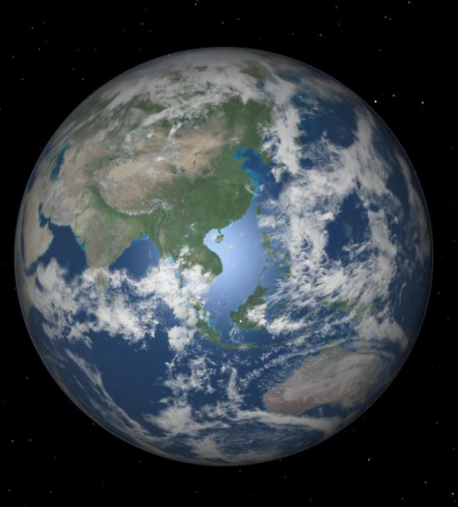
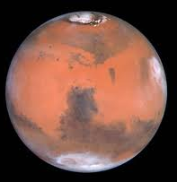
Case Study: James Lovelock—“The Gaia Hypothesis”
Lovelock stumbled on the Gaia Hypothesis
working for NASA/USon the search for life on Mars.
He used Earth as a model: What fingerprint does life
leave in the chemistry of Earth’s atmosphere? An
atmosphere far from chemical equilibrium—lots of
free oxygen coexisting with highly reactive gases like
methane and only traces of oxidated gases like CO₂.
Life replenishes oxygen and removes CO₂. We can
know that Mars is lifeless, without having to send
instruments there (at enormous expense), because its
atmosphere is in a state of chemical equilibrium.
In his first book, Gaia: A New Look at Life on Earth, Lovelock recounts
a personal narrative of how he discovered the existence of Gaia.

Slide 35
Case Study: James Lovelock—“The Gaia Hypothesis”
The Gaia Hypothesis itself has become a public narrative, now
memetically competing to become a grand cultural narrative.
The essence of the Gaia Hypothesis is that life does not merely adapt to
the existing conditions on planet Earth, except at its inception.
Indeed, at life’s inception, conditions on the Earth were very
different than they are today. Rather, once established life
transforms, refines, and regulates conditions on planet Earth that
are favorable to life itself. The living Earth is a cybernetic
system that life maintains: a global temperature regime between
the boiling and freezing points of water in the face of ever
increasing solar radiation; an alkaline ocean pH favorable to the
formation of calcium carbonate shells; and a constant ocean
salinity in the face of continuous salt inputs from freshwater
draining land masses.

Slide 36
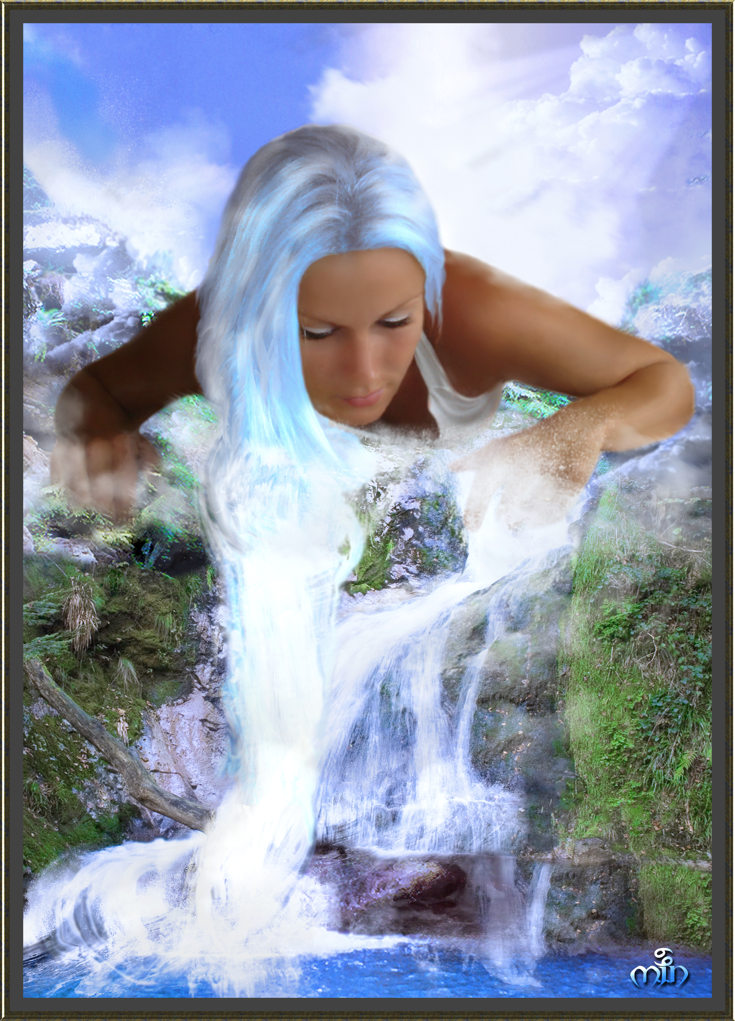
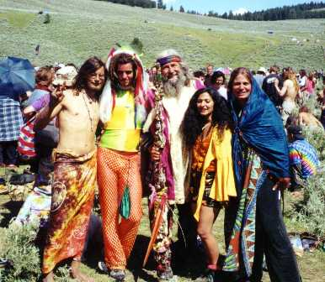
Case Study: James Lovelock—“The Gaia Hypothesis”
At first, the Gaia Hypothesis was a pariah in the scientific community
of discourse for two reasons:
At points Lovelock seemed to personify and
attribute foresight and conscious agency to Gaia—
in short, commit the sin of teleology.
(2) The Gaia Hypothesis became popular in communities of discourse for which
many scientists had contempt—
New Age mysticism.

Slide 37
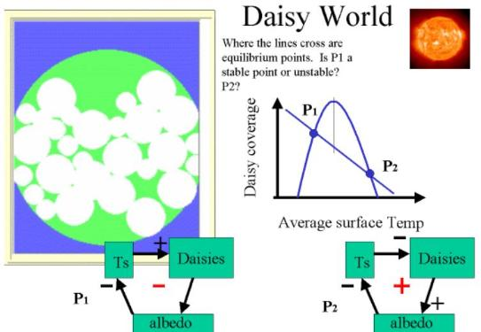
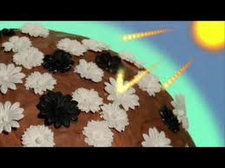
Case Study: James Lovelock—“The Gaia Hypothesis”
Lovelock responded with another narrative, “Daisy World”—a world
consisting of two species of daisy—one white, one black. Computer
simulations showed that these two species could regulate the “planet”’s
temperature, in blind Darwinian competition with one another, like a
simple unintelligent thermostat—black daisies prevailing when the
temperature fell below the optimum, white daisies prevailing when
it rose above.

Slide 38
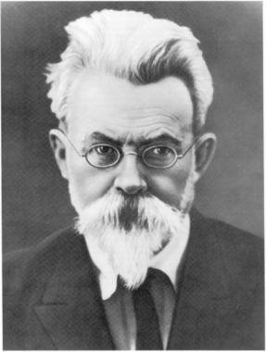
Case Study: James Lovelock—“The Gaia Hypothesis”
The Gaia Hypothesis was anticipated by
Vladimir Vernadsky in La Biosphere,
published in Paris in 1929. Vernadsky
pointed out that living matter had not only
massively transformed the Earth’s atmosphere
and the hydrosphere but had also massively
affected the earth’s lithosphere by generating
sedimentary rocks most notably as limestone,
travertine, and marble–among many other
species of minerals. Vernadsky invented the science of planetary
biogeochemistry and speculated about the metaphysical
differences between living matter and inert matter.

Slide 39
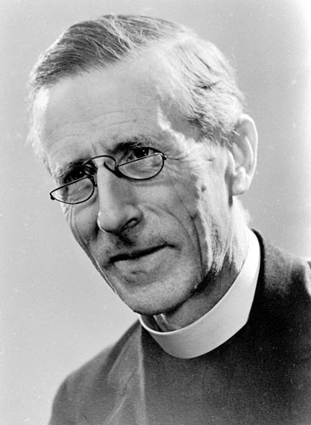
Case Study: James Lovelock—“The Gaia Hypothesis”
Stimulated by conversations with Pierre Teilharrd
de Chardin, Vernadsky subsequently
speculated on the emerging existence of a
nöosphere. But, in sharp contrast to
Teilhard’s matter-spirit dualistic metaphysics,
Vernadsky was a resolute materialist and his
nöosphere was far more pedestrian—the
collective corpus of scientific knowledge that,
when applied technologically, was more rapidly and efficiently
doing what living matter has always done—reorganizing the inert
matter on Earth to suit itself.

Slide 40
Case Study: James Lovelock—“The Gaia Hypothesis”
Aldo Leopold faintly sketched the Gaia Hypothesis in 1923, several
years before Vernadsky, in a paper that was posthumously published
the same year (1979) as Lovelock’s first Gaia book.
“[It] is at least not impossible to regard the earth’s parts—soil,
mountains, rivers, atmosphere, etc.—as organs or parts of organs, of a
coordinated whole, each part with a definite function. And, if we could
see this whole, as a whole, through a great period of time, we might
perceive not only organs with coordinated functions, but possibly also
that process of consumption and replacement which in biology we call
the metabolism or growth. In such a case we would have all the visible
attributes of a living thing, which we do not now recognize to be such
because it is too big and its processes too slow. And there would also
follow that invisible attribute—a soul or consciousness—which …
many philosophers of all ages ascribe to all living things and
aggregations thereof, including the‘dead’ earth.”
Notes:
Struggling to understand a regional-scale flip from one ecological
domain of attraction—savannah to brush—Leopold explores
the boundaries between climatic and ecological temporal scales in
“Some Fundamentals”

Slide 41
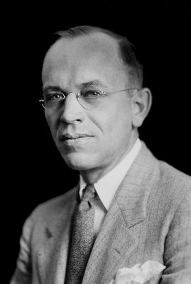
Case Study: James Lovelock—“The Gaia Hypothesis”
“There is not much discrepancy, except in language,
between this conception of a living earth, and the
conception of a dead earth, with enormously slow,
intricate, and interrelated functions among its parts,
as given us by physics, chemistry, and geology. The
essential thing, for present purposes, is that both admit
the interdependent functions of the elements. . . .
Possibly, in our intuitive perceptions, which may truer
than our science and less impeded by words than our
philosophies, we realize the indivisibility of the earth—its soil,
mountains, rivers, forests, climate, plants, animals, and respect it
collectively, not only as a useful servant but a living being, vastly less
alive than ourselves in degree, but vastly greater than ourselves in time
and space—a being that was old when the morning stars sang together*,
and, when the last of us has been gathered unto his fathers**, will still be
young.” *Job 38.7; **Kings 22:20.

Slide 42
Case Study: James Lovelock—“The Gaia Hypothesis”
Various interpretations of Gaia’s soul or consciousness
Early Lovelock and his critics: a directive, intervening, teleological
planetary intelligence.
Vernadsky: nascent and emergent discourse community of science,
integrating into a planetary network and collective intelligence.
Leopold: analogous to animal consciousness—ancient, but
emergent and epiphenomenal.
Margulis: subconcious proprioceptive sensoria—e. g., the way
we and other animals maintain our balance

Slide 43
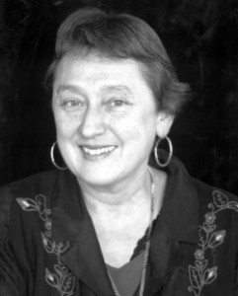
Case Study: James Lovelock—“The Gaia Hypothesis”
What is the moral of the Gaia narrative?
Leopold indicates that it inspires respect for the
Earth as a living being, suggesting that the
Earth might be the beneficiary of a
non-anthropocentric environmental ethic.
But the temporal scale of that living being—
now existing, changing, evolving, for
3.5 billion years suggests that we humans
cannot actually harm Gaia herself in any way at all. We might be
the agents of a mass extinction event, but Gaia has undergone 5
such in the past, only to speciate and biodiversify ever more
profusely. As the late Lynn Margulis, a Gaia theorist, puts it:
“Gaia is tough bitch and the mother of invention.” It is the height
of human hubris to think that we are responsible for Earth care.

Slide 44
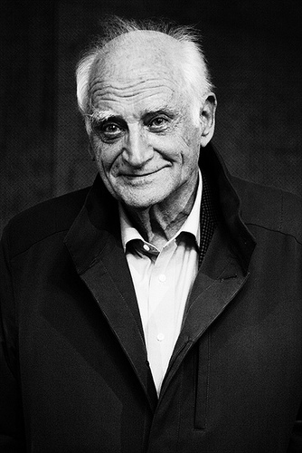
Case Study: James Lovelock—“The Gaia Hypothesis”
In The Revenge of Gaia, Lovelock echoes Michel
Serres in Le Contrat Naturel, using military
metaphors to characterize our new relationship
with the planet. We have been making war on
Gaia and Gaia is striking back principally
through climate change. We are biologically
adapted to the cold Pleistocene climate in
which our species evolved and to the optimal
Holocene climate in which our species
flourished. A sudden transition to something approaching the
Eocene maximum might result in a collapse of global civilization,
in the face of risen sea levels, shrinking continents, expanded
deserts, violent storms and protracted droughts.

Slide 45
Case Study: James Lovelock—“The Gaia Hypothesis”
The moral of the Gaia grand narrative is anthropocentric
Gaia is too big, too old, and too resilient to be harmed by us humans.
But we humans can force changes in the chemistry Gaia’s atmosphere
and hydrosphere, flipping the planet into a new climatic regime and
thus radically altering the planetary conditions to which we are
adapted. Our species is probably not at risk of extinction, but
our complex, evermore interconnected, and evermore fragile global
civilization might well collapse in the face of a radically changed
planet. A new Dark Age and new era of Barbarism looms ominously
on the temporal horizon. We must care not for the Earth per se,
not for Gaia herself, but we must take care to preserve the current state
of the Earth for the sake of sustaining the civilization and culture of
which we are the current custodians.

Slide 46
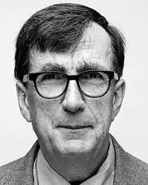
Case Study: James Lovelock—“The Gaia Hypothesis”
The Gaia narrative is now the focal point of what I call
NeoPresocratic philosophy—a mélange of
phusis, logos, ethikê, and polis
The “politics” of Lovelock and Serres is an
Authoritarian scientocracy. Having demystified
science with his “science studies,” in Politiques de la
Nature, Bruno Latour democratizes the sciences as
“ways of socializing nonhumans” . . . “capable of being
seated as citizens” . . . in “a parliament of things.”
Most basically, “the lovely Gaia hypothesis” is a newly
composed global collective, for Latour, requiring the
constitution of new political institutions.
Following Latour, and (perhaps unwittingly)
echoing Vernadsky’s notion of living matter, Jane
Bennett, in Vital Matter: A Political Ecology of Things,
also constructs a Gaian narrative of environmental
responsibility.

