Slide 1
Convictions &
Urban Solidarities
Presentation to Stakeholders
07/02/13

Slide 2
1. Where are we now?
2. What did we learn so far?
3. Where are we going?

Slide 3
Sept. 2010
June 2012
Listening campaign launched
Oct. 2012
PWR renounces to project in Brussels
Nov. 2012
Belgian team targets 2015

Slide 4
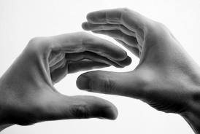
Cohesion
Objectives
Dialogue
Dialogue
Cooperation

Slide 5
1. Where are we now?
2. What did we learn so far?
3. Where are we going?

Slide 6
362 people interviewed
(through 216 individual interviews & 32 focus groups)
Convictions
Geography
Hindu, Bahai, Buddhist, Sikh, Free-Mason, & Spiritual
Women: 40%
Youngsters (< 26 year): 20%

Slide 7
A different approach to dialogue
Bottom-up
Taking time
Identity as starting point

Slide 8
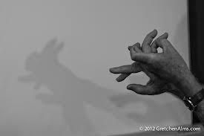
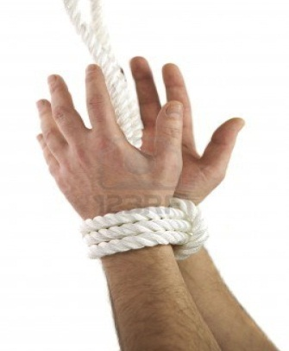
Inspiring
stories
Lessons from
youngsters
Voiceless
First
Key findings
Lateral
approach
Safe
places

Slide 9
1. Where are we now?
2. What did we learn so far?
3. Where are we going?

Slide 10
Achieving more with less?
(a smaller budget for a more rooted project)
Original PWR budget
Phase 1 921.000 *
Listening Campaign
(June 12 – May 13)
Phase 2
Networking the dialogue
(Jan. 13 – July 14)
Phase 3
Event
(Aug. 14)
_________
7.821.000
New proposed budget
Phase 1 462.850 * (-49%)
Listening Campaign
(June 12 – Sept. 13)
Sept 13
Phase 2
Networking the dialogue 1.500.000
(Jan. 13 – July 15)
6.900.000 **
July 15
Phase 3 600.000 **
Event
(Aug. 15)
_________
2.562.850 (-67%)
Aug. 15
* Afterwards reduced to 718.000
** Event for 10.000 participants during 6 days
* Funds received
- Fondation Roi Baudoin 65.000 (dons privés)
- Private 247.850
- Government 50.000
- Toerisme Vlaanderen 40.000 (office)
- Corporate 100.000
** Event for 1.000 participants during 3 days

Slide 11
Phase 1
462.850 € budget used by end August
June12
Jan. 13
April 13
Aug. 13
Collection of interviews & Focus Group
338.000 €
(incl. fees paid to Chicago)
Detailed analysis of LC & Preliminary report
48.000 €
Writing, translating & publishing final report
66.850 €
4.8 ETP + costs
2,5 ETP + costs
2 ETP + costs

Slide 12
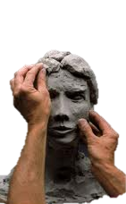
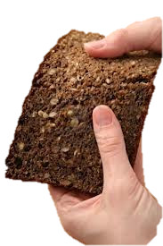
Phase 2
Activities’ Pillars
Exchange
Create
Share
Grow

Slide 13
Phase 2
Potential activities
Preferably supporting existing activities; to be validated with field; non-exhaustive
Exchange
Words
Conferences & debates
Living libraries
Webinars
Speed-dating
Tandems discoveries
Extract from budget worksheet
Silences
Silent Space(s) (permanent)
Writings
Stickers with quotes harvested in the Listening Campaign
Articles/columns in newspapers
…
Budget
(estimate)
240.000 € (16% budget total; incl. indirect costs)

Slide 14
Phase 2
Potential activities
Preferably supporting existing activities; to be validated with field; non-exhaustive
Create
Music
Sacred music concerts
Inter-convictionnal Concerts
Music festival (annual)
Movies
Film followed by debate
Other arts
Artistic discoveries & exhibitions visits
Sacred places visits
Artistic creations (film, theatre play, music, poetry)
Street chalk drawings, urban collage,…
…
Budget
(estimate)
520.000 € (35% budget total; incl. indirect costs)

Slide 15
Phase 2
Potential activities
Preferably supporting existing activities; to be validated with field; non-exhaustive
Share
Meals
Meal offered by one to other convictions
Annual inter-convictionnal meal
Sports
Sport tournaments followed by debate with role models
City Games (skate,…)
Other entertainements
Comedy or jokes contests
Quiz
…
Budget
(estimate)
200.000 € (13% budget total; incl. indirect costs)

Slide 16
Phase 2
Potential activities
Preferably supporting existing activities; to be validated with field; non-exhaustive
Grow
For teachers
Supporting the development of tools for teachers to sustain inter-dialogue
Manual on the definition, methodology and relevant themes for interconvictional dialogue in schools.
Training sessions in interconvictional dialogue for teachers.
Dutch version of "Dieu, Adonaï, Allah et moi«
…
For youngsters at school
Inter-and intra dialogue meetings within a safe place
…
Budget
(estimate)
540.000 € (36% budget total; incl. indirect costs)

Slide 17
Phase 2
1.5 mio € for 28 months
April 13
Sept.13
Febr. 14
July 15
Inventory, who’s who & networking
100.000 €
Gradual launch of activities *
250.000 €
Deployment of all activities in partnership with associations
1.150.0000 €
2,1 ETP + costs
3.8 ETP + costs
4.8 ETP + costs
Extract from budget worksheet

Slide 18
Phase 3
600k € for the 2015 Event (1.000 participants/3 days)
Exchange
Create
Share
Grow
Conferences with luminaries,
Workshops organized by associations & communities
Debates on the LC themes
Book fair
Drafting of “Brussels Declaration”
…
Exhibitions
Cooking sessions
Concerts
Dance
…
Show Place for initiatives
Proposals for synergies
Sharing of best practices, testimonies, discoveries,…
…
Realizations of schools classes
Exhibitions of the tools used in schools
…
…preparing phase 4

Slide 19
New governance
Advisory committee
Steering committee
Honorary committee
Executive
committee
We need your help!

Slide 20
New name
?

Slide 21
Thank you!
If you want to help us,
don’t hesitate to contact
Pierre Géhot
p.gehot@skynet.be

