Slide 1
Tip Toeing around mindfulness: On mindful performativity in organizations
Vinca Bigo
Kedge BS
Fabien Moreau
Rennes university
Christophe Vignon
Kedge BS

Slide 2
From Critical Performativity to Mindful Performativity
Critical Management Studies
Psychoanalysis
Queer studies
Philosophy
Spirituality
Coaching

Slide 3
Performativity in CMS
Micro emancipation beyond neo marxism (Alvesson & Willmott 1992)
Anti or non performativity (Fournier & Grey 2000)
The practice turn (Schatzki T.R., K. Knorr-Cetina and E. Von Savigny. 2001)
Denaturalisation (Willmott & Alvesson 2003)
Performative Utopias (Parker et al. 2007)
Decaf resistance (Contu 2008)
Critical performativity (Spicer et al. 2009)
Critical Leadership (Alvesson & Spicer 2012)
Resistance beyond negative ontologies (Lok and Willmott 2014)

Slide 4
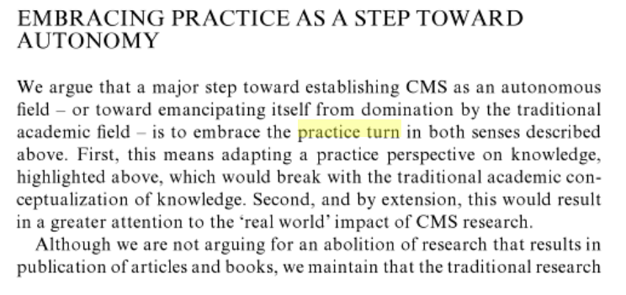
The Practice Turn 2001

Slide 5
The Practice Turn 2001

Slide 6
Spicer, Alvesson & Kärreman 2009
We argue that critical management studies (CMS) should be conceptualized as a profoundly performative project. The central task of CMS should be to actively and pragmatically intervene in specific debates about management and encourage progressive forms of management.
This involves CMS becoming affirmative, caring, pragmatic, potential focused, and normative. To do this, we suggest a range of tactics including affirming ambiguity, working with mysteries, applied communicative action, exploring heterotopias and engaging micro-emancipations. (abstract Spicer et al. 2009)

Slide 7
Critical Performativity in CMS
Ontological aims
Social transformation, emancipation, resistance
Epistemological aims
Critical research performativity tactics
For whom
Members of the organizations
Researchers

Slide 8
Performativity & Psychoanalysis
An ontology of (unconscious) affects and ambivalence
Importance of the reality principle
Reducing projections, illusionary and distorted views of the world
Going beyond our desire, memories and knowledge (Korff-Sausse 2014, Bion 1965)
Resisting normalising positivities (Laclau & Mouffe 1985, 2001)
Ontology of affects and organizational emancipation (Fotaki et al. 2012)
Beyon negative ontologies: a space for resistance (Lok and Willmott 2014)

Slide 9
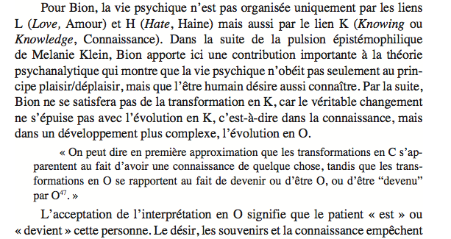
Bion 1965

Slide 10
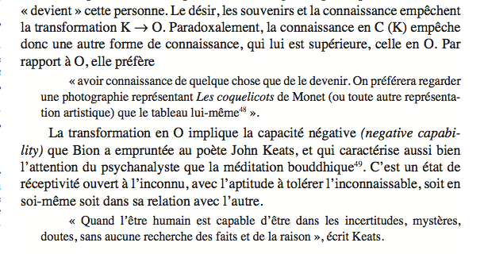
Bion 1965

Slide 11
Performativity & Queer Theory
On Butler “Our behaviour either cements or undermines social gender norms” (Moi 2008: 262)
Reification of reality
“Gender […] was a performative effect of heterosexist and heteronormative power structures.” (Moi 2008: 262)
“promulgate the hegemonic materialization process” (Prezi 2014)
Resistance
“Profound performativity seems to be the process of accessing the excluded space in order to destabilize the hegemonic materialization process, challenge as it were the normative descriptors (Ex: woman)” (Prezi 2014)

Slide 12
Performativity & Philosophy
Heidegger
Acquiring knowledge as a process of coping that implies abstracting from the world implying a loss in accuracy
The break down of coping as an opportunity to access otherness
“Anxiety,’ he writes, ‘discloses...beings in their full but heretofore concealed strangeness as what is radically other” (Heidegger 1977a:105)
“It must be stated that entities as entities are ‘in themselves’ and independent of any apprehension of them; yet, the being of entities is found only in encounter and can be explained, made understandable, only from the phenomenal exhibition and interpretation of the structure of encounter” (Heidegger 1985a: 217).
(Dreyfus in Schatzki et al. 2001 The Practice Turn)

Slide 13
Performativity & Philosophy
Heidegger points to two special attitudes (confronting equipmental breakdown and anxiety) that, on the face of it, break out of our everyday, equipment-using practices. Since Heidegger bases his account of meaning on equipment-using practices, he concludes that such special attitudes, by ‘deworlding’ entities, break out of our everyday meanings altogether and give us access to the ‘incomprehensible’ as it is in itself. But, if one has a broader conception of everyday meaning that includes perceiving things outside of use-relations, such a ‘switchover’ would not get one outside the everyday (Dreyfus 2001: 164)

Slide 14
Performativity & Philosophy
Gender, Psychoanalysis & Philosophy
Acquiring knowledge with care (Hollway 2006)

Slide 15
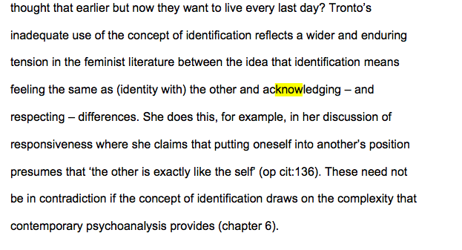
Hollway 2006

Slide 16
Performativity & Spirituality
Spirituality 2.0 (mindfulness, presencing, slow management, the flow)
Being here and now
Withholding judgment, embracing neutrality
Recognizing emotional states (fear, anger, frustration, ambivalence)
Embracing paradoxes
Connecting with openness of heart
Demonstrating empathy, compassion

Slide 17
Spirituality 2.0
Mindfulness : Thich Nhat Hanh. (1992, 1999)
Flow: Csikszentmihalyi, Mihaly (1990)
Servant leadership: Greenleaf, R. K. (1977)
Slow leadership, management, food…
Presencing: Otto Scharmer (2007)

Slide 18
Consciousness manipulation & freedom
Aware of outer (others and organizational dynamics), but not of inner world (self) epistemic
Liable to manipulate others
Unconscious of inner and unaware of outer world Conscious of inner and aware of outer world
epistemic and ontic epistemic and ontic
Liable to being manipulated and manipulate others Beyond manipulation, and able to foster compassionate connections
Inner freedom with a capacity to foster outer freedom
Conscious of inner but unaware of outer world ontic
Liable to being manipulated by others

Slide 19
From darkness to freedom
Episteme
Denaturalisaton Micro emancipation
Reificaiton Non performativity
Critical performativity tactics
Profoundly mysterious performativity
Reality principle
Bion
DARKNESS Dasein FREEDOM
Unconscious Critical Mindfulness Conscious
Psychoanalysis of affects & manipulation Practice Turn Critical leadership
Performative utopias
Queer performativity
Servant leadership
Care
Presencing
Flow
Slow management
Ontos /being

Slide 20
Performativity & Coaching
Foucauldian resistance (Pezet 2007)
Unintended consequences of coaching in enhancing performance (Arnaud et al. 2005)

Slide 21
Performativity born out in Coaching
Our field work : the story of the coach in four stages
alienated
leaves
studies to be coach
becomes coach in organizations with ambivalent feelings

Slide 22
C23: The goat attached to the post
There is a paradox here ! Because, normally, the manager, by definition, is responsibe and autonomous […] the image is […] the goat attached to the post
The fair posture is […] to be in the present time […] the responsability of the coach is to frame and say « ok we can go even if we didn’t plan to work on this », even more when in a tripartite contract, it’s a bit more complicated […] there is something to reinvent about the liberty

Slide 23
C8: narcissistic reparation
Reach a position of eminence grise, of power […] in my becoming coach, there is a dimension of narcissistic reparation […] recognise affects
This aristocratic dimension […] i.e. this distinction between the noble and the vile, the vile is … the operator who is believing to operate, IS operated […] while he thinks he is a subject, and I, who is apart from the production cycle and system, and avoid to be operated […] and pretend to make some Subject beyond dualism

Slide 24
C4 : coach of the system rather than coach of the symptom
We have to be coach of the system rather than coach of the symptom
Why did I chose to be in the helping relationship ? […] … narcissistic problems, self-image […] the fantasy that was mine, if I care for people more hurt than me, it will fit me
Another motivation which is not … blameless, it is the pursuit of power
Recgonise and transcend affects, paradoxes, duality

Slide 25
C3 : the Human at the heart of the company
My mission is to contribute to the better-being in the company […] I’m at the service of this
It’s to put back the Human at the heart of the company […] at the service of the Human (laughing), […] of the personal fulfliment
This ... responsibility of the company about the moral and physical health of its workers […] [my] offer and the demand might meet (laughing)
Compassion (Ricard 2014)

Slide 26
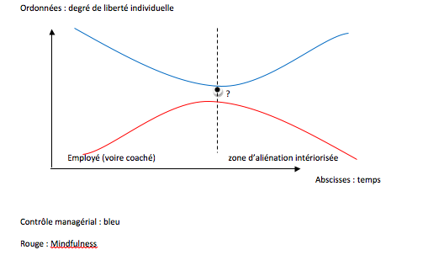
Darkness

Slide 27
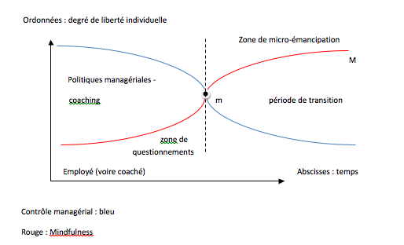
Mindful performativity

Slide 28
Critical Performativity in CMS
Ontological aims
Social transformation, emancipation, resistance
Epistemological aims
Critical research performativity tactics
For whom
Members of the organizations
Researchers

Slide 29
Mindful Performativity
Subject conscious of inner world
Emotional stability, neutrality, not indifference
Subject aware of and open to connection with of outer world
Compassion
Neutrality and compassion - CMS research ethics & emancipatory objectives for social transformation
Barriers to (active and passive) manipulation - dark side

Slide 30
Mindful Performativity
Non naïveté as to possible dark performative intentions
Troyan horse
Interdisciplinary voyage

Slide 31
references
Bion, W.R. (1965), Transformations, paris, puf, 1982.
Butler, Judith (1988) Performative Acts and Gender Constitution: An Essay in Phenomenology and Feminist Theory, Theatre Journal, Vol. 40. No. 4 pp. 519-531
Csikszentmihalyi, Mihaly .1990. Flow: The Psychology of Optimal Experience. New York, NY: OUP
Contu, A. (2008). Decaf resistance: On misbehavior, cynicism, and desire in liberal workplaces. Management Communication Quarterly, 21, 364-379. Dreyfus, H. L. (2001). “How Heidegger Defends the Possibility of a Correspondence Theory of Truth with Respect to the Entities of Natural Science.” In T. R. Schatzki, K. Knorr Cetina & E. von Savigny (eds.), The Practice Turn in Contemporary Theory. London: Routledge. Pp. 159-171.
Fotaki, Marianna, Susan Long & Howard S. Schwartz (2012): “What Can Psychoanalysis Offer Organization Studies Today? Taking Stock of Current Developments and Thinking about Future Directions”. Organization Studies. 33 (9), pp. 1104–1120.
Greenleaf, R. K. 1977. Servant leadership: A journey into the nature of legitimate power and greatness. New York: Paulist. Hollway, W. (2006) The Capacity to Care: Gender and Ethical Subjectivity. London: Routledge.
Korff-Sausse Simone, 2014 “Bion et la philosophie orientale”, Le Coq-héron, 2014/1 n° 216

Slide 32
references
Lok J. and H. Willmott 2014. Identities and Identifications in Organizations: Dynamics of Antipathy, Deadlock, and Alliance. Journal of Management Inquiry. 2014, Vol. 23(3) 215–230
Moi, Toril. 2008. “I am not a woman writer: About women, literature and feminist theory today”. Feminist theory. Vol. 9(3): 259-271.
Ricard, M. 2014. Plaidoyer pour l’altruisme. Edt Nil.
Schatzki T.R., K. Knorr-Cetina and E. Von Savigny. (2001), The practice turn in contemporary theory, Routledge.
Scharmer, O. 2007. Theory U. Leading from the future as it emerges. SoL. Spicer A., M. Alvesson M and D. Kärreman D. (2009) Critical performativity: The unfinished business of critical management studies, Human Relations, Vol. 62, n°4, pp. 537-560.
Thich Nhat H. (1999). The heart of the Buddha’s teaching. New York, NY: Broadway Book
Wolfram Cox, J., Le Trent-Jones, T.G., Voronov, M. and Weir, D. (Eds.). 2009. Critical management studies at work: Negotiating tensions between theory and practice. Cheltenham, UK: Edward Elgar.

