Slide 1
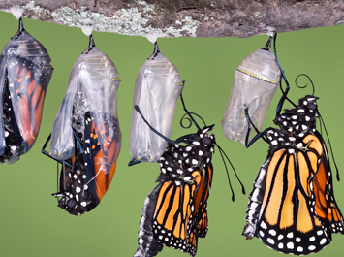
Réinventer la gestion d’entreprise
Rencontre Beloeil
08/05/15
Laurent Ledoux
www.philoma.org
ledoux.laurent@gmail.com

Slide 2
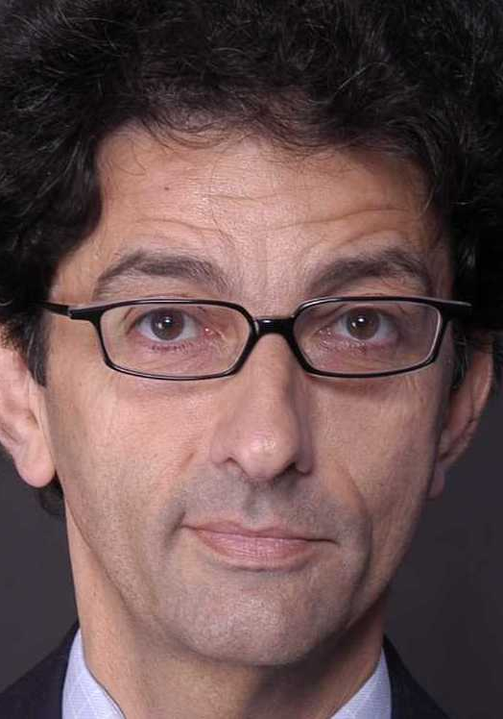
Getz
Laloux
Human dynamics
Personal & evolutionary growth
Self-direction
Intrinsic equality & wholeness

Slide 4
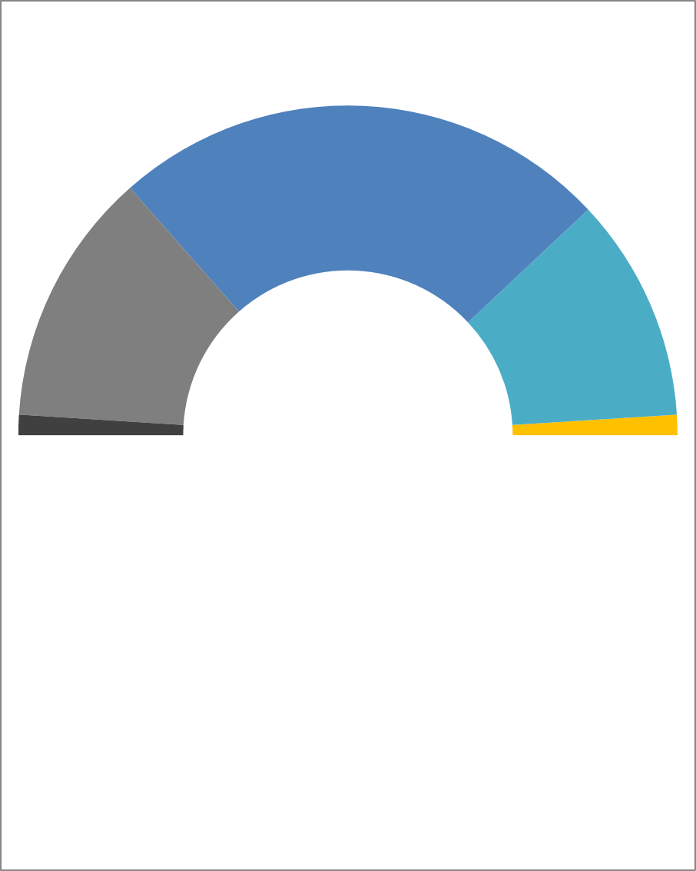
The 5 stages of culture
Language
Relationship to People
5
“Life is great”
Team
4
“We’re great”
Stable partnership
3
“I’m great”
Personal domination
2
“My life sucks”
Separate
“Life sucks”
3
1
Alienated
49%
2
25%
22%
4
From “Tribal leadership” by Logan, King & Fischer-Wright, 2008; adapted by Ledoux
1
2%
2%
5

Slide 5
Team management principles
Inspired by Isaac Getz (Freedom Inc.)
Intrinsic equality
Personal growth
Capacity to self-direct

Slide 6
1
Whyway
Intrinsic
equality
Open conversations
Participation
Diversity
2
Humility
Ignorance’s strength
Transparency
No titles
3
Fairness
Wage gap reduction
Bonus sharing
Open space for all
Everybody wants to take initiatives

Slide 7
1
Exploration
Personal
growth
Open trainings
Collective intelligence
Godfathers
2
Trust
Risky appointments & recruitments
Errors tolerance
Faith in their resilience
3
Benevolence
Craftsmanship
Dignity
Coherence
Everybody is able to take initiatives
7

Slide 8
1
Adults
Capacity to self-direct
No rules
No credos
No monkeys
2
Engagement
Team practices
Common good
Societal projects
3
Let go
Loosen-up
Balcony
Vanish
Everybody has the liberty to take initiatives

Slide 12
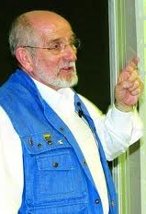
Human dynamics
Le chef
doit savoir s’effacer pour laisser croître l’entreprise
Zobrist – 2005
Le meilleur leader est celui dont le groupe connaît
à peine l’existence
Lao Tseu – 630 av. JC.
Laozi, 630 ac

Slide 13
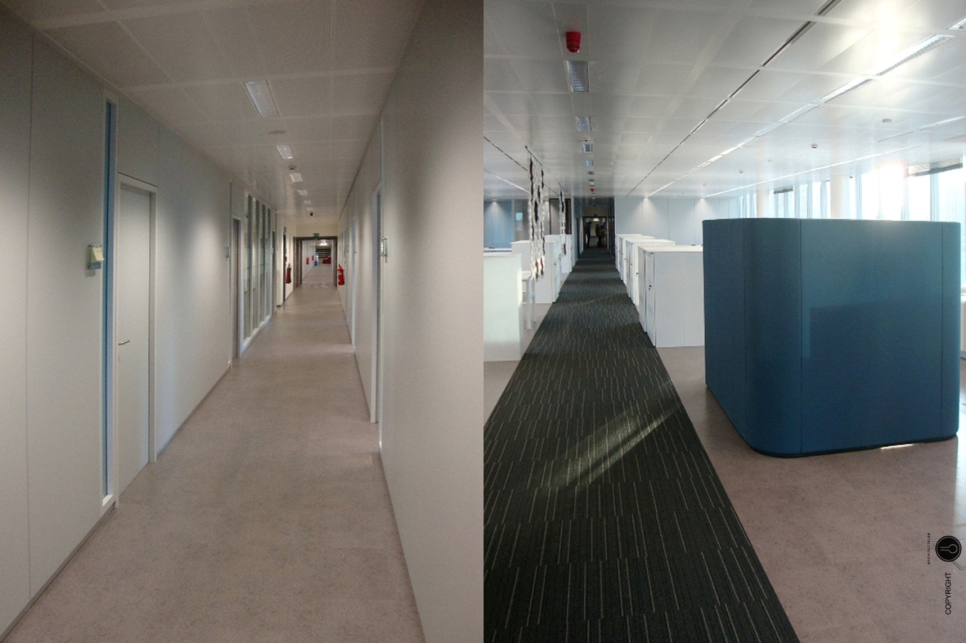
Change management
voor
na

Slide 14
Van weerstand naar fan

Slide 15
Werken op afstand
tot 2 dagen telewerk
federaal satellietkantorennetwerk

Slide 16
vertrouwen

Slide 17
Processen aanpassen

Slide 18
RESULTATEN

Slide 19
Facility
City Atrium
CCN
Haren
Volledig heringericht tegen 1/7/2015
CCN verlaten op 1/6/2014
Haren verlaten op 1/6/2014
- 4.000 m²
- 11.000 m²
- 4.000 m²
39.000 m² ➔ 20.000 m²

Slide 20
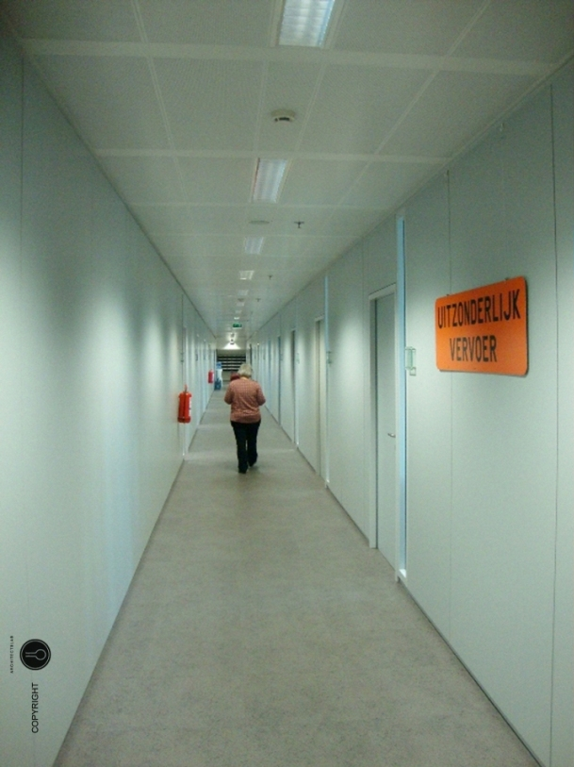
Facility
1100 1-op-1 werkplekken
➔➔
750 flex desks

Slide 21
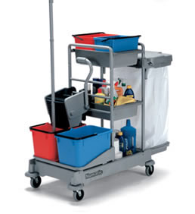
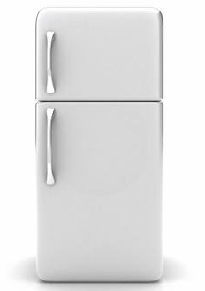
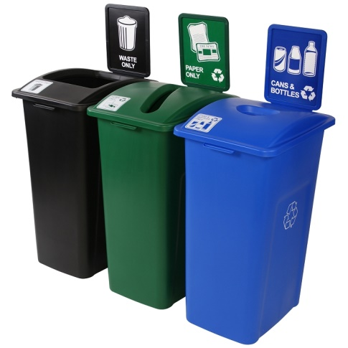
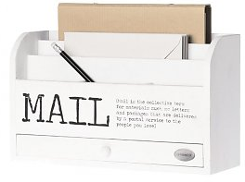
Facility
17 FTE omgeschoold
100 ➔ 30
2000 ➔ 40
600 ➔ 20

Slide 22
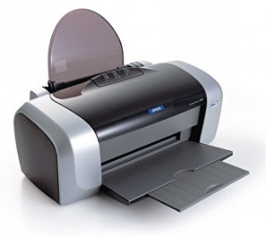
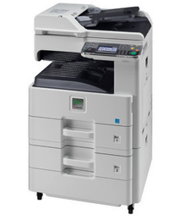
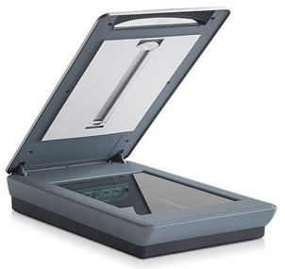
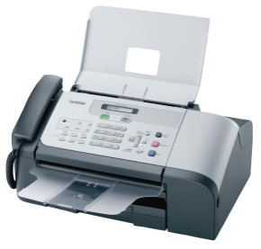
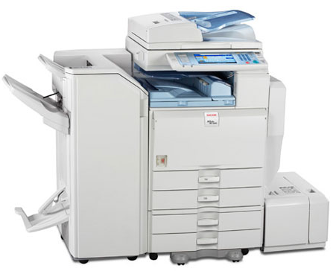
Facility
580
60
40
25
100 ➔ 30
30 multifunctionele printers

Slide 23
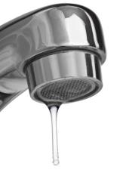
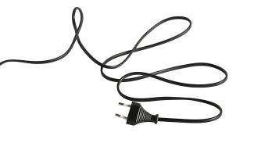
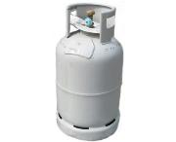
Facility
ecologische voetafdruk aanzienlijk verminderd

Slide 24
Budgettair
City Atrium
CCN
Haren
Huurkosten
2.800.000 euro
Exploitatiekosten
1.000.000 euro
Personeelskosten
300.000 euro
Totale jaarlijkse besparing
4.100.000 euro
Totale investering
5.700.000 euro

Slide 25
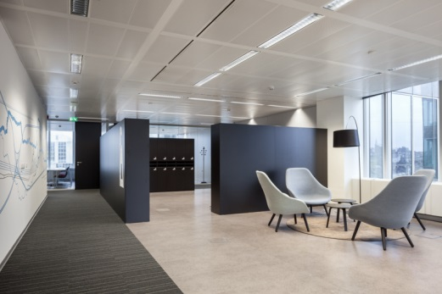
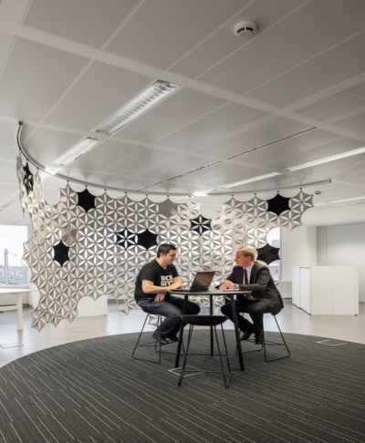
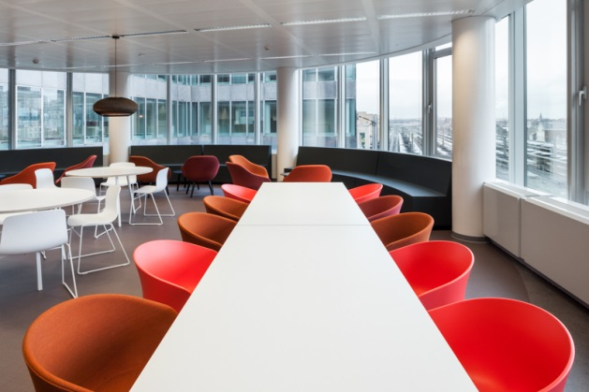
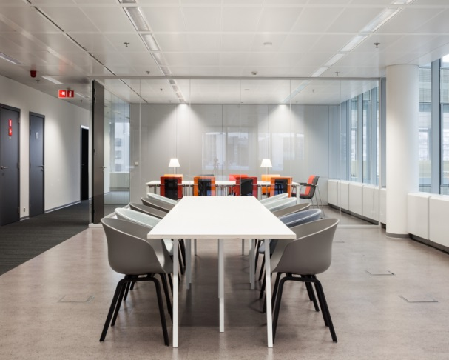
Dynamic office

Slide 26
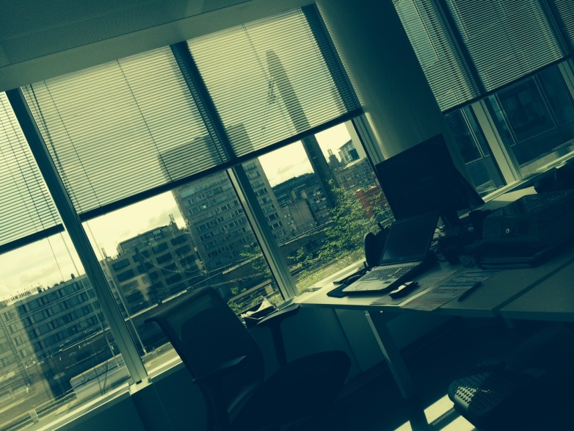
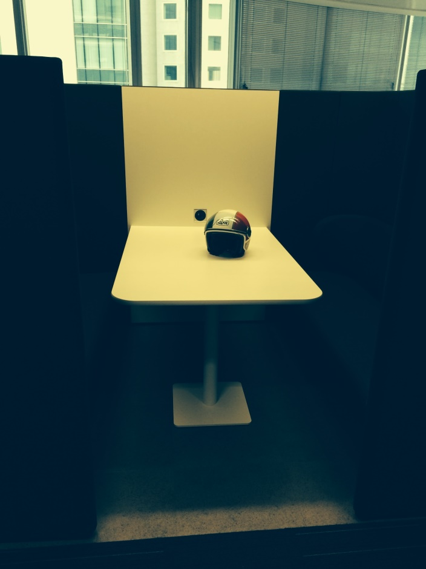
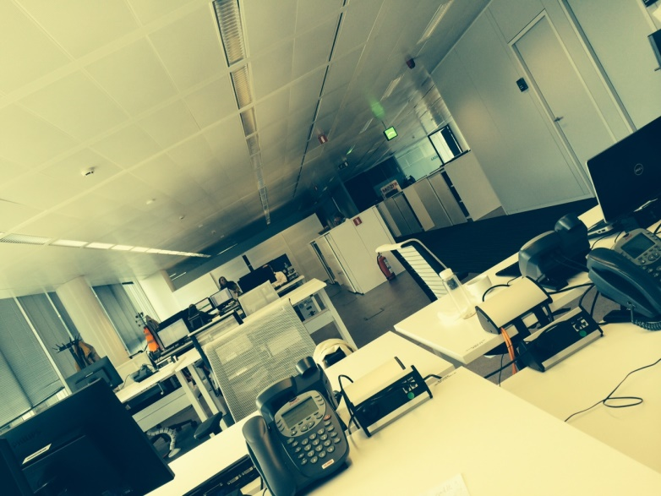
DYNAMIC OFFICE : CHANGER LA PERSPECTIVE !

